Slide 1
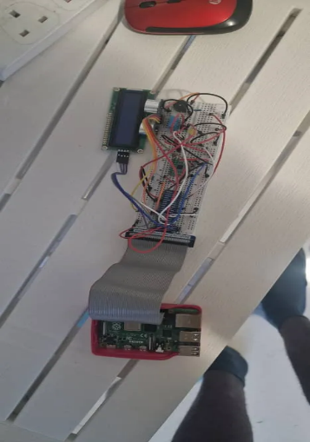
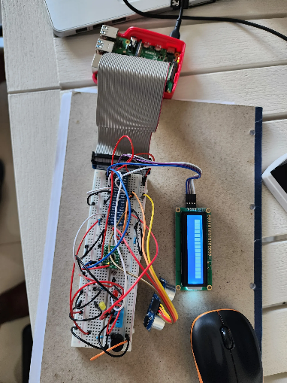
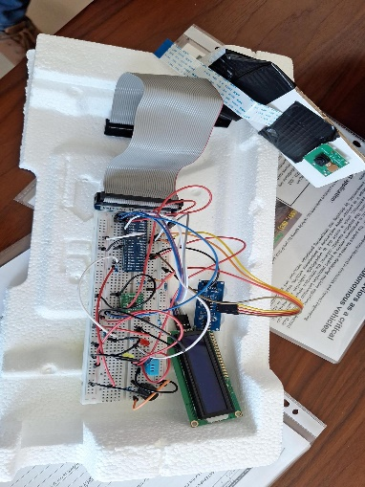

PROJECT NAME
Student name: MORGAN CHINEDU OFODUM
Course/year: EMBEDDED SYSTEMS/2024 - 2025
Project Description: AUTOMATED SMART HOME MONITORING WITH REMOTE ACCESS
Project application: THE SYSTEM IS USED IN HOMES AND OFFICES
Project process: This smart home system monitors humidity, temperature, light, and movement in a designated area. When light levels drop below a threshold, the system activates a red light to illuminate the area. Upon detecting movement, the system triggers an alarm. Additionally, it flashes a yellow light when temperature and humidity is being monitored and the readings recorded appropriately. These readings are sent to a designated email in real time and can be accessed remotely via a designated website. The camera captures images whenever movement is detected and records video when the area is dark and the red light is activated
SPACE FOR PHOTOS OF THE PROJECT
Exhibit produced by students at the Malta College for Arts, Science and Technology (MCAST).

